Slide 1
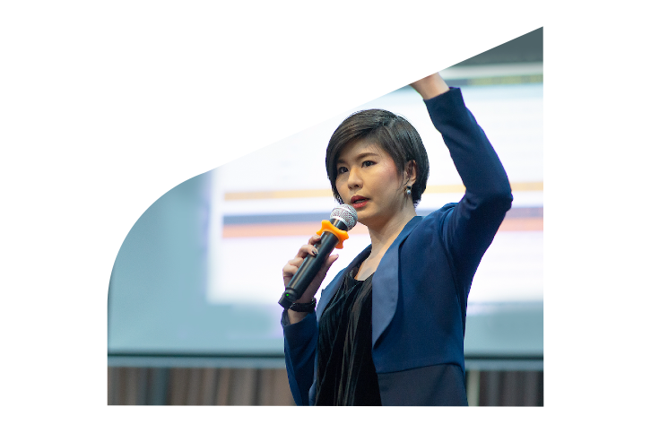
Join my session LIVE in-person at Asia Health 2022
19-21 October 2022
IMPACT Exhibition Center - Bangkok
Register for free

